Slide 1
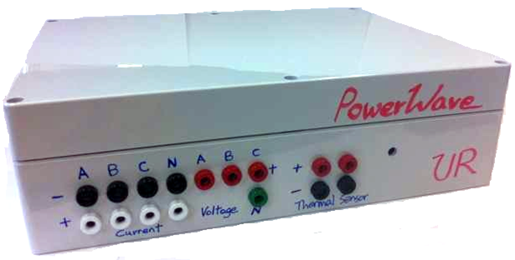
Wireless Building Power Monitoring System
Project by Ka (David) Fung and Pak Lam (Jack) Yung
Mentored by Professor Thomas B. Jones
University of Rochester
Department of Electrical and Computer Engineering
Spring 2012 to Spring 2013
Contributions by Professor Wendi Heinzelman, John Simonson, Lucas Crandall, Gabriel Unger, and James Meyers

Slide 2
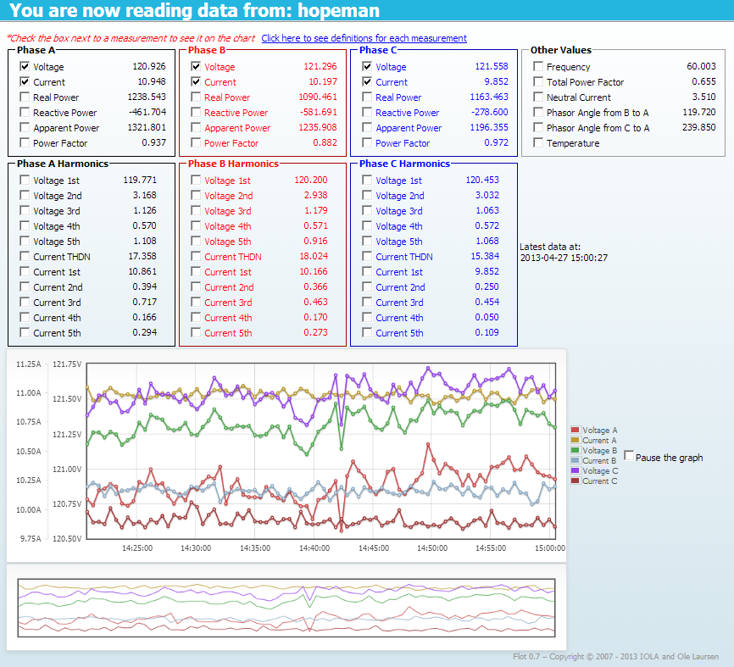
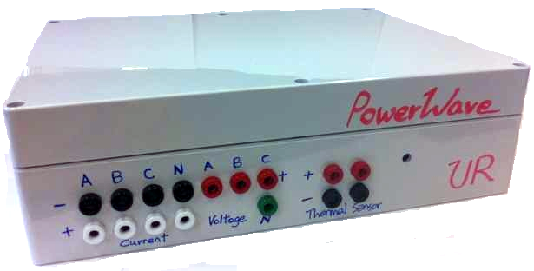

System Overview
Measurement Device
Server
Online Interface

Slide 3
Three Parts of the System
Measurement Device
Server
Online Interface
Arduino Mega 2560 (Microcontroller)
Currently using the University’s server
MAXQ3183 (Power measurement chip, AFE from Maxim)
WiFly Shield (Wifi module from Sparkfun)
Apache server with MySQL database
Written in PHP and JavaScript

Slide 4
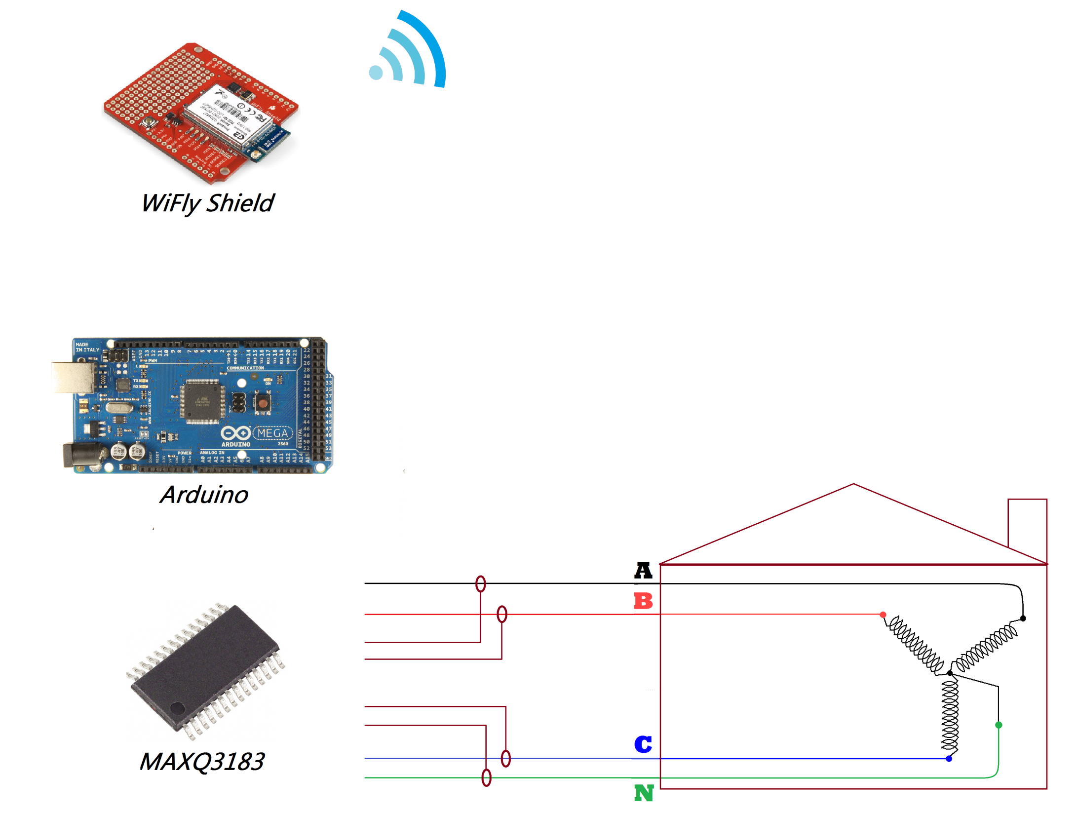
Measurement Device
Arduino is the master controller of the device
SPI communication between modules
Measurements are obtained by reading registers in MAXQ3183
WiFly shield only provides wireless capability
MAXQ3181 and its supporting circuitry is on a custom PCB board

Slide 5
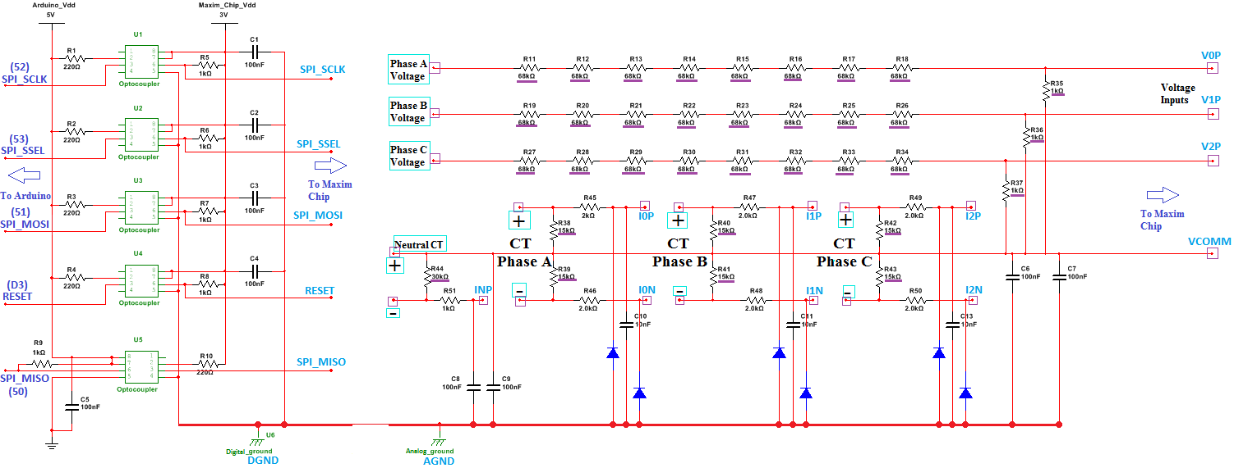
Supporting Circuitry on Custom PCB
Resistor values with purple underline are adjustable to accommodate different input ranges
Optocouplers are to isolate the Arduino and WiFly from the “hot board” (Maxim chip and high voltage lines), as well as to convert voltage signals (5V for Arduino and 3V for MAXQ3183)
Neutral line is connected to AGND
Default internal ADC voltage reference is 2.048V. All differential inputs are relative to VCOMM, which is 1.024V above GND, so the MAX AMPLITUDE OF ANY INPUT SIGNAL SHOULD BE LESS THAN 1.024V

Slide 6
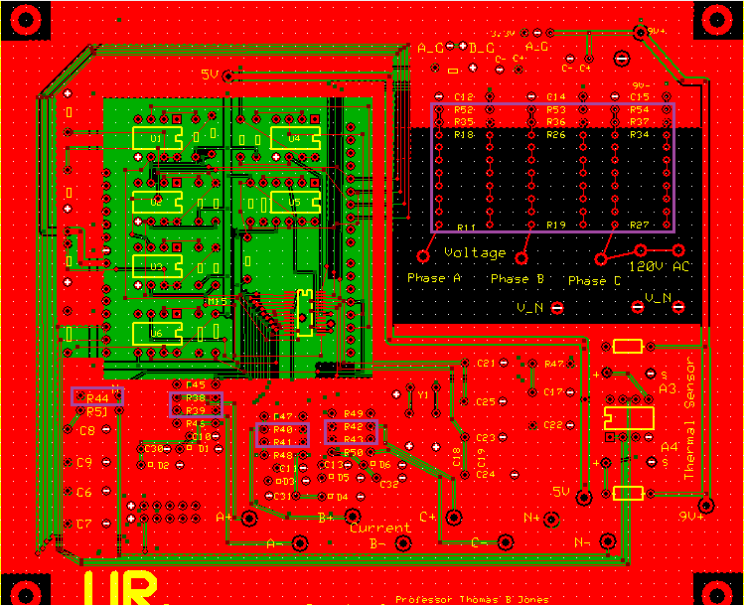
Resistors to be Adjusted

Slide 7
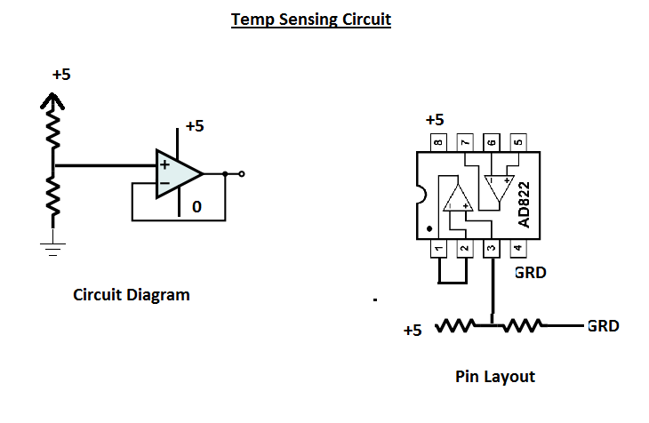
Voltage signal goes directly to Arduino’s ADC

Slide 8
Few Details on the Measurement Device
MAXQ3183 Measurement Chip
Operates at 8MHz
ADC samples all analog inputs in 360us (2778 samples per second)
Line parameters are calculated every DSP cycle
A DSP cycle is the time of a line cycle multiplied by cycle count (programmable)
With a nominally 60Hz line cycle (16.67ms) and the cycle count default value of 16: a DSP cycle is nominally 266.72ms
SPI Communication
Communicates at 1MHz (this is limited by MAXQ3183)
One channel shared by both WiFly and MAXQ3183
Slave select line determines which slave can use the share channels

Slide 9
Arduino Program
chip_test_mega.ino
(Main functions: setup and loop)
initial_register_writes.ino
(MAXQ3183’s configuration and calibration registers)
normalread.ino
(Reading non-harmonic measurements)
harmread.ino
(Reading harmonic measurements)
maxim_read.ino
(Function to read from MAXQ3183)
maxim_write.ino
(Function to write to MAXQ3183)
asciitoint.ino
(Helper function for maxim_read and maxim_write)

Slide 10
Server Information
Host Name: enterprise.seas.rochester.edu
Webpage is in directory
/var/www/html/ece/projects/power
Server OS: CentOS 5.9
PHP version: php-5.1.6-39.el5_8
MySQL version: 5.0.95

Slide 11
Webpage Information
Live view, schedule data collection, view recorded data
PHP is the scripting language, used mainly in the latter two options
Live view uses JavaScript extensively
“jQuery”, JavaScript library to perform AJAX (Asynchronous JavaScript and XML) to continuously pull new data from the server for live view
“Flot”, JavaScript plotting library for jQuery to do the live plot

Slide 12
Website Pages and Scripts
index.html
(home page)
index.php
(members home page)
live.php
old.php
schedule.php
livepull.php
arduino_read.php
create_schedule_
template.php
device_call.php
Main Display Pages Scripts that perform main functions
Include files
arduino_insert.php
devicelist.php
(Whitelist of device names)
(Included in all files)

Slide 13
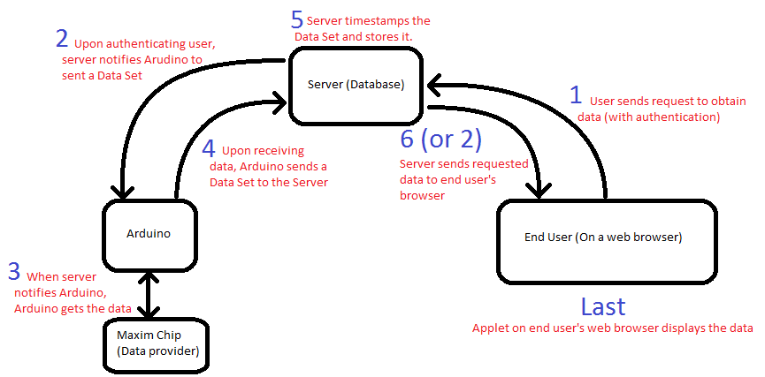
System Operation Overview

Slide 14
Problems with the System
Harmonic readings are slow
Limitation of MAXQ3183
Around ½ second for each additional harmonic measurement if different harmonic measurements are read in series
Everything on the Arduino program is hardcoded
Calibration is hardcoded
Set of measurements read is hardcoded
WiFly Shield’s wireless security protocol choices are limited
Currently require a dedicated SSID that uses WPA2-PSK (AES) from the University wireless network: Roving1
This SSID is not available at every access point
Website’s scheduling function requires rework
The “at” program currently used to schedule the data collection task on the server is not ideal

Slide 15
Improvement Suggestions
Implement the functionality where the Arduino program can take in commands
This will allow remote calibration of the Maxim chip, instead of hardcoding
Implement the functionality where the end user can select which measurements to read
This is the other part of the above suggestion, to cut down the long readings delay
Better error detection/recovery
WiFly sometimes does not respond to commands, requires reset
“Timeout” messages halts the live view when the WiFly is pre-occupied
Finer calibration of the measurements
A lot of calibration registers are untouched
Include a USB port on the box for easier access to Arduino

